Slide 1


Slide 2

Agenda
Infrastructure
SAPUI5 / Fiori
Bosch Infrastructure
OData Protocol
Entity & Entity Set
Filter, Sorter, Top Skip
SAPUI5
MVC: Model View Controller
XML View
Controller (Java script)
Model (JSON, ODATA)
Gateway
Entity & Entity Set
Filter, Sorter, Top Skip
GET, POST, PUT, DELETE
Central Hub Deploy
/IWFND/MAINT_SERVICE
/IWFND/ERROR_LOG
Fiori Launchpad
Catalog
Group
Authorization
Role concept & assignment
Check missing roles & authorization
2
Internal | RBVH/ETI22 | 2017-12-06
© Robert Bosch Engineering and Business Solutions Vietnam Company Limited 2017. All rights reserved, also regarding any disposal, exploitation, reproduction, editing, distribution, as well as in the event of applications for industrial property rights.

Slide 3
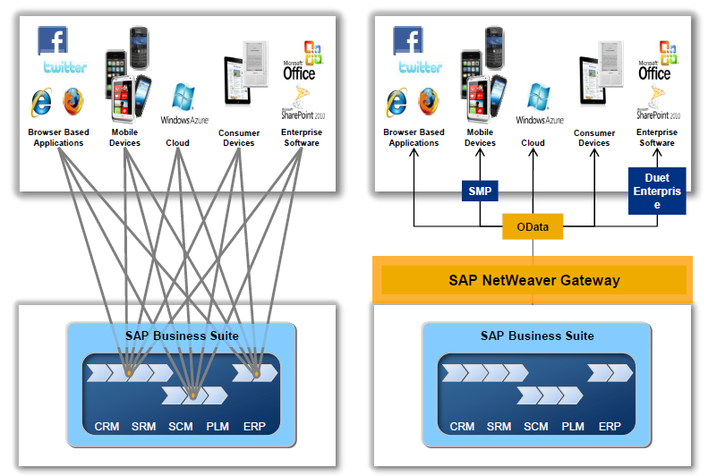
SAP Net weaver Gateway
Infrastructure
3
Internal | RBVH/ETI22 | 2017-12-06
© Robert Bosch Engineering and Business Solutions Vietnam Company Limited 2017. All rights reserved, also regarding any disposal, exploitation, reproduction, editing, distribution, as well as in the event of applications for industrial property rights.

Slide 4
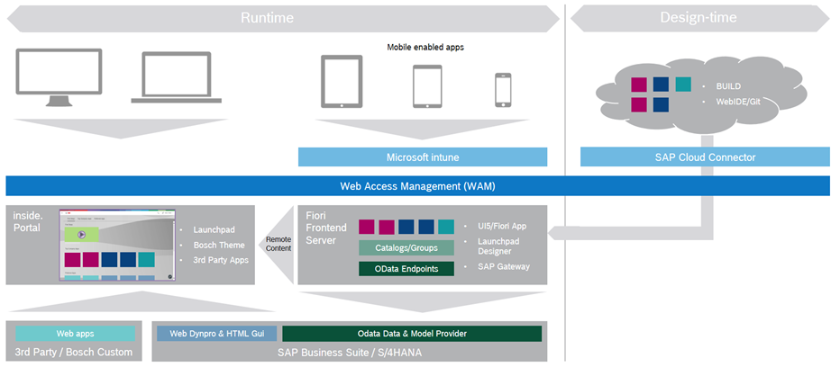
Bosch’s Landscape
Infrastructure
4
Internal | RBVH/ETI22 | 2017-12-06
© Robert Bosch Engineering and Business Solutions Vietnam Company Limited 2017. All rights reserved, also regarding any disposal, exploitation, reproduction, editing, distribution, as well as in the event of applications for industrial property rights.

Slide 5
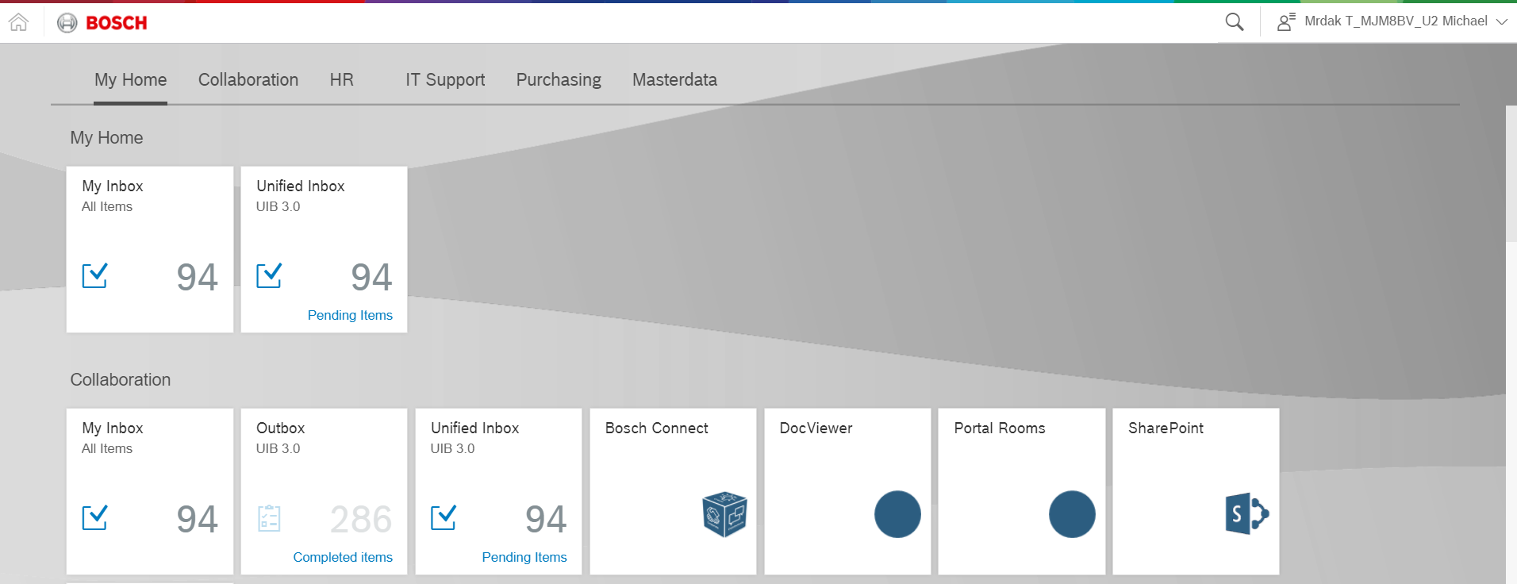

Portal Launchpad
2nd Level Support For Fiori
Go To
Catalog
5
Internal | RBVH/ETI22 | 2017-12-06
© Robert Bosch Engineering and Business Solutions Vietnam Company Limited 2017. All rights reserved, also regarding any disposal, exploitation, reproduction, editing, distribution, as well as in the event of applications for industrial property rights.

Slide 6
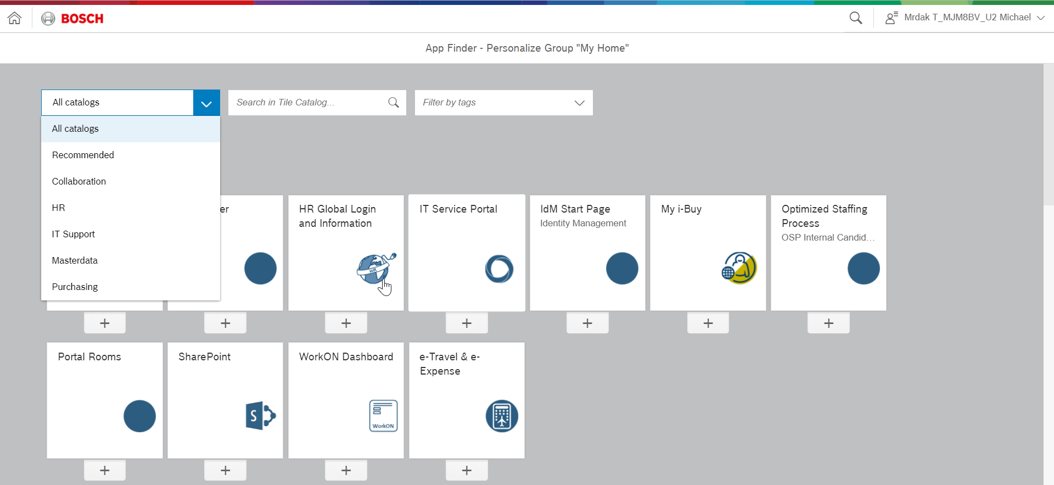
Launchpad Catalog
2nd Level Support For Fiori
Append manually a tile from catalog to a group on home
6
Internal | RBVH/ETI22 | 2017-12-06
© Robert Bosch Engineering and Business Solutions Vietnam Company Limited 2017. All rights reserved, also regarding any disposal, exploitation, reproduction, editing, distribution, as well as in the event of applications for industrial property rights.

Slide 7
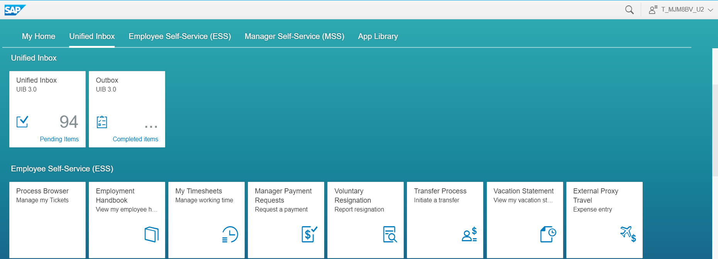
Fiori Launchpad
2nd Level Support For Fiori
If tile displays on Fiori Launchpad but it disappears in portal ➔ missing portal role
7
Internal | RBVH/ETI22 | 2017-12-06
© Robert Bosch Engineering and Business Solutions Vietnam Company Limited 2017. All rights reserved, also regarding any disposal, exploitation, reproduction, editing, distribution, as well as in the event of applications for industrial property rights.

Slide 8
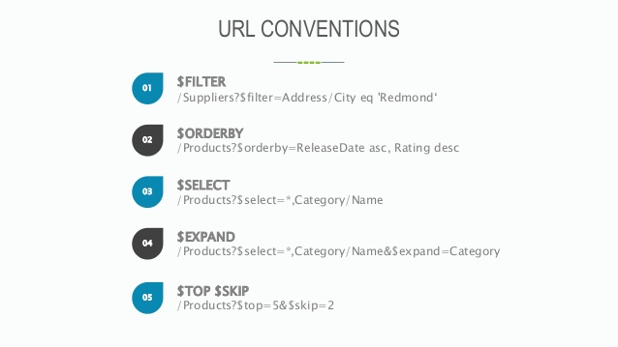

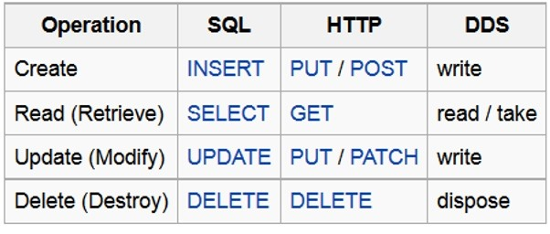
OData Protocol
2nd Level Support For Fiori
OData (Open Data Protocol) is an ISO/IEC approved, OASIS standard that defines a set of best practices for building and consuming RESTful APIs. OData helps you focus on your business logic while building RESTful APIs without having to worry about the various approaches to define request and response headers, status codes, HTTP methods, URL conventions, media types, payload formats, query options, etc. OData also provides guidance for tracking changes, defining functions/actions for reusable procedures, and sending asynchronous/batch requests.
OData RESTful APIs are easy to consume. The OData metadata, a machine-readable description of the data model of the APIs, enables the creation of powerful generic client proxies and tools.
8
Internal | RBVH/ETI22 | 2017-12-06
© Robert Bosch Engineering and Business Solutions Vietnam Company Limited 2017. All rights reserved, also regarding any disposal, exploitation, reproduction, editing, distribution, as well as in the event of applications for industrial property rights.

Slide 9

OData: Demo
9
Internal | RBVH/ETI22 | 2017-12-06
© Robert Bosch Engineering and Business Solutions Vietnam Company Limited 2017. All rights reserved, also regarding any disposal, exploitation, reproduction, editing, distribution, as well as in the event of applications for industrial property rights.

Slide 10
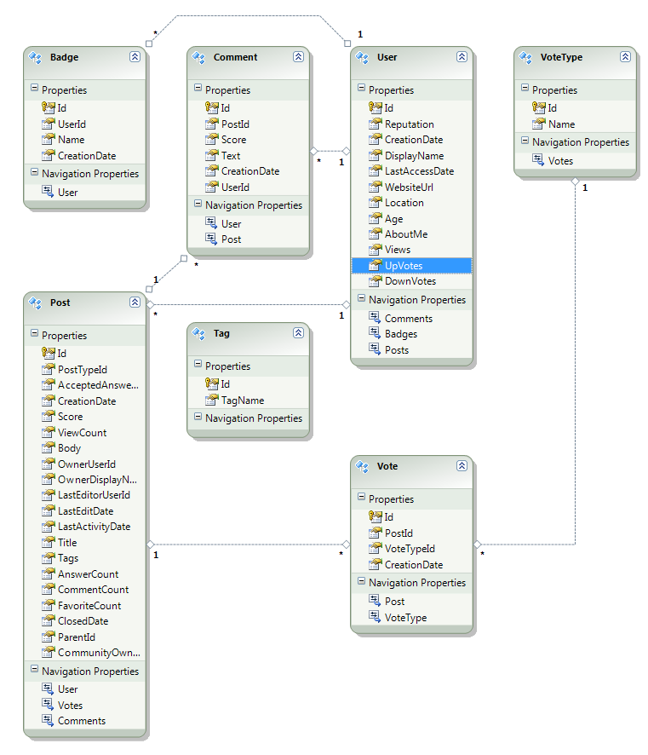
OData Protocol: Association
2nd Level Support For Fiori
10
Internal | RBVH/ETI22 | 2017-12-06
© Robert Bosch Engineering and Business Solutions Vietnam Company Limited 2017. All rights reserved, also regarding any disposal, exploitation, reproduction, editing, distribution, as well as in the event of applications for industrial property rights.

Slide 11
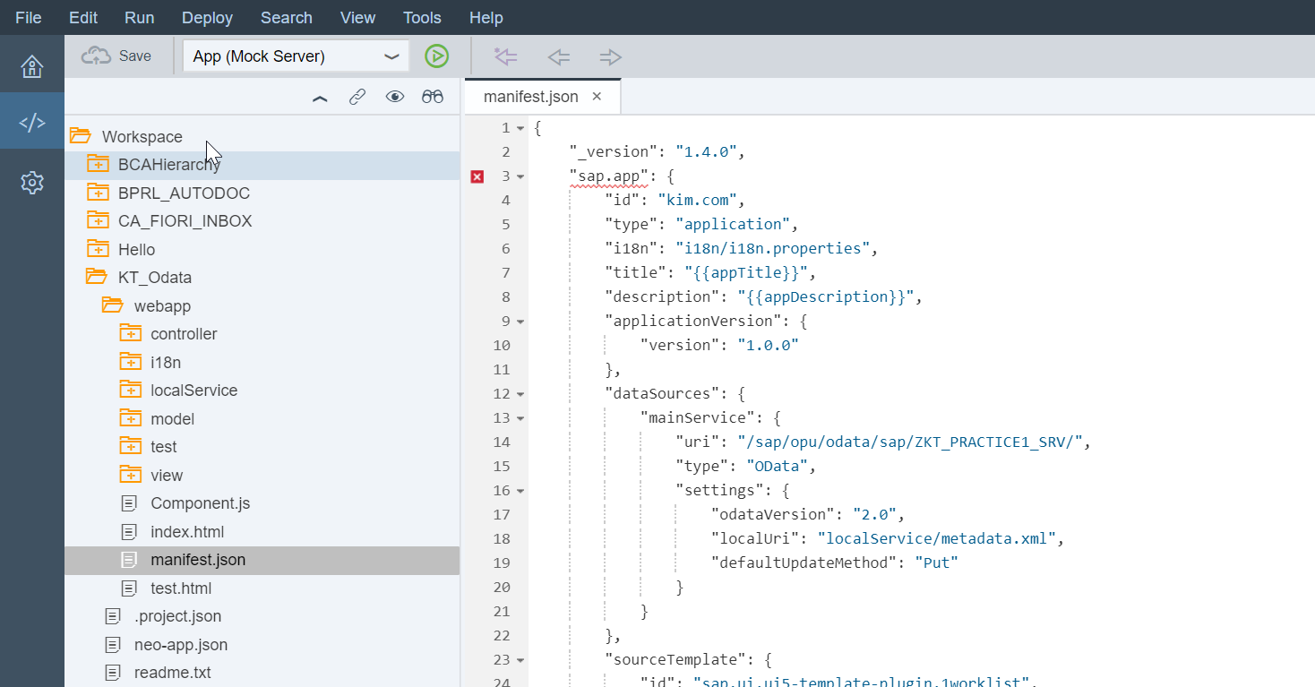
SAPUI5: MVC
11
Internal | RBVH/ETI22 | 2017-12-06
© Robert Bosch Engineering and Business Solutions Vietnam Company Limited 2017. All rights reserved, also regarding any disposal, exploitation, reproduction, editing, distribution, as well as in the event of applications for industrial property rights.

Slide 12
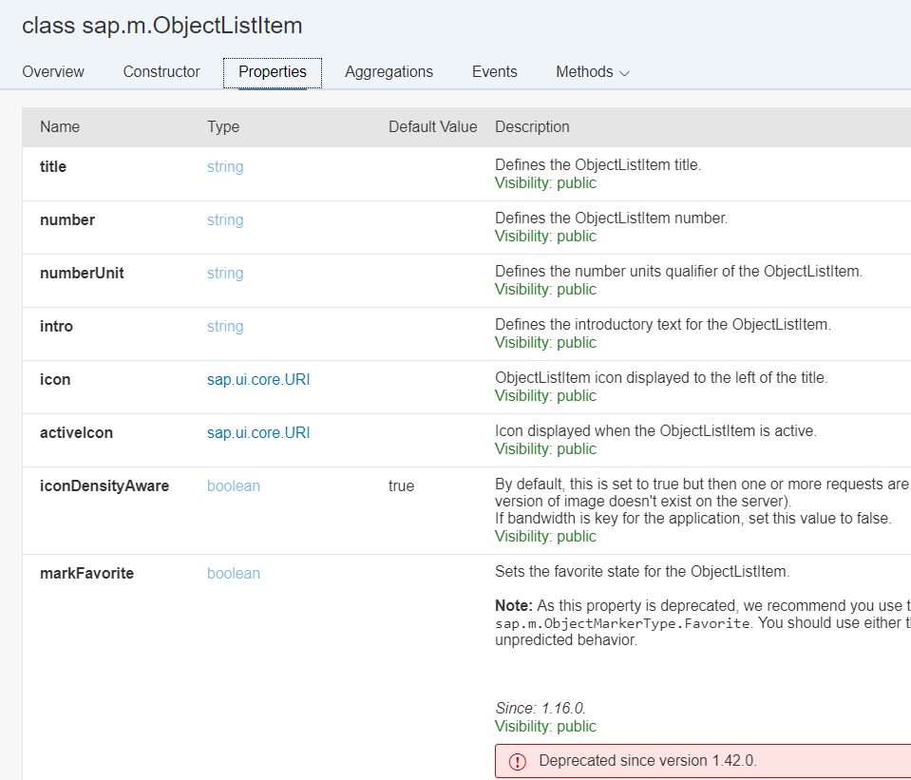
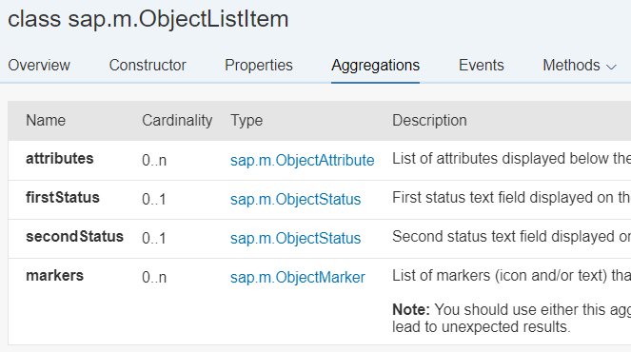
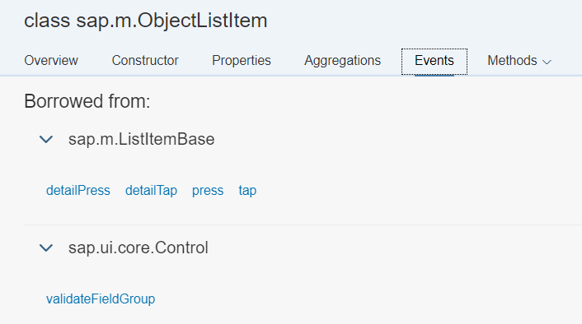
SAPUI5: API
12
Internal | RBVH/ETI22 | 2017-12-06
© Robert Bosch Engineering and Business Solutions Vietnam Company Limited 2017. All rights reserved, also regarding any disposal, exploitation, reproduction, editing, distribution, as well as in the event of applications for industrial property rights.
Notes:
https://sapui5.hana.ondemand.com/sdk/#content/Overview.html

Slide 13
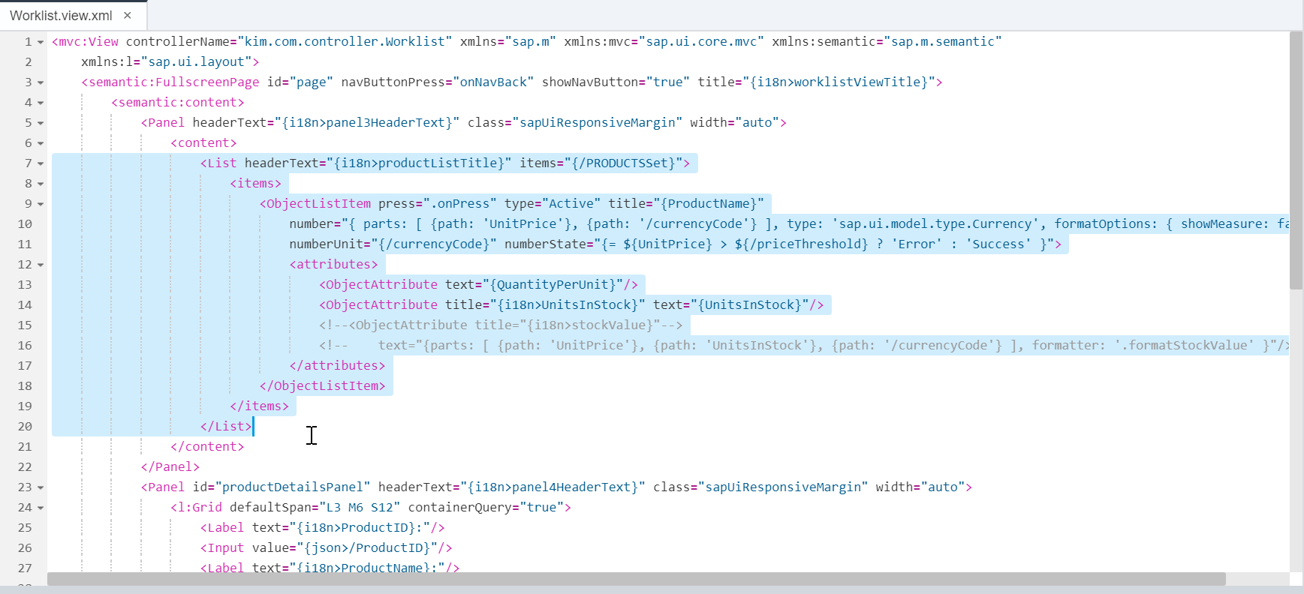
SAPUI5: XML View
13
Internal | RBVH/ETI22 | 2017-12-06
© Robert Bosch Engineering and Business Solutions Vietnam Company Limited 2017. All rights reserved, also regarding any disposal, exploitation, reproduction, editing, distribution, as well as in the event of applications for industrial property rights.

Slide 14
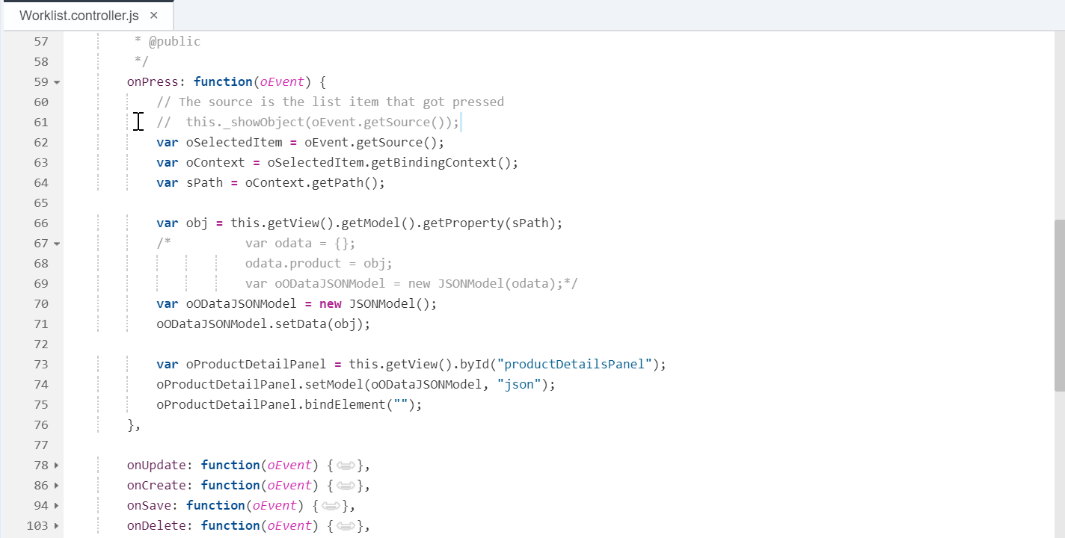
SAPUI5: Controller
14
Internal | RBVH/ETI22 | 2017-12-06
© Robert Bosch Engineering and Business Solutions Vietnam Company Limited 2017. All rights reserved, also regarding any disposal, exploitation, reproduction, editing, distribution, as well as in the event of applications for industrial property rights.

Slide 15
SAPUI5: Debugging
15
Internal | RBVH/ETI22 | 2017-12-06
© Robert Bosch Engineering and Business Solutions Vietnam Company Limited 2017. All rights reserved, also regarding any disposal, exploitation, reproduction, editing, distribution, as well as in the event of applications for industrial property rights.

Slide 16
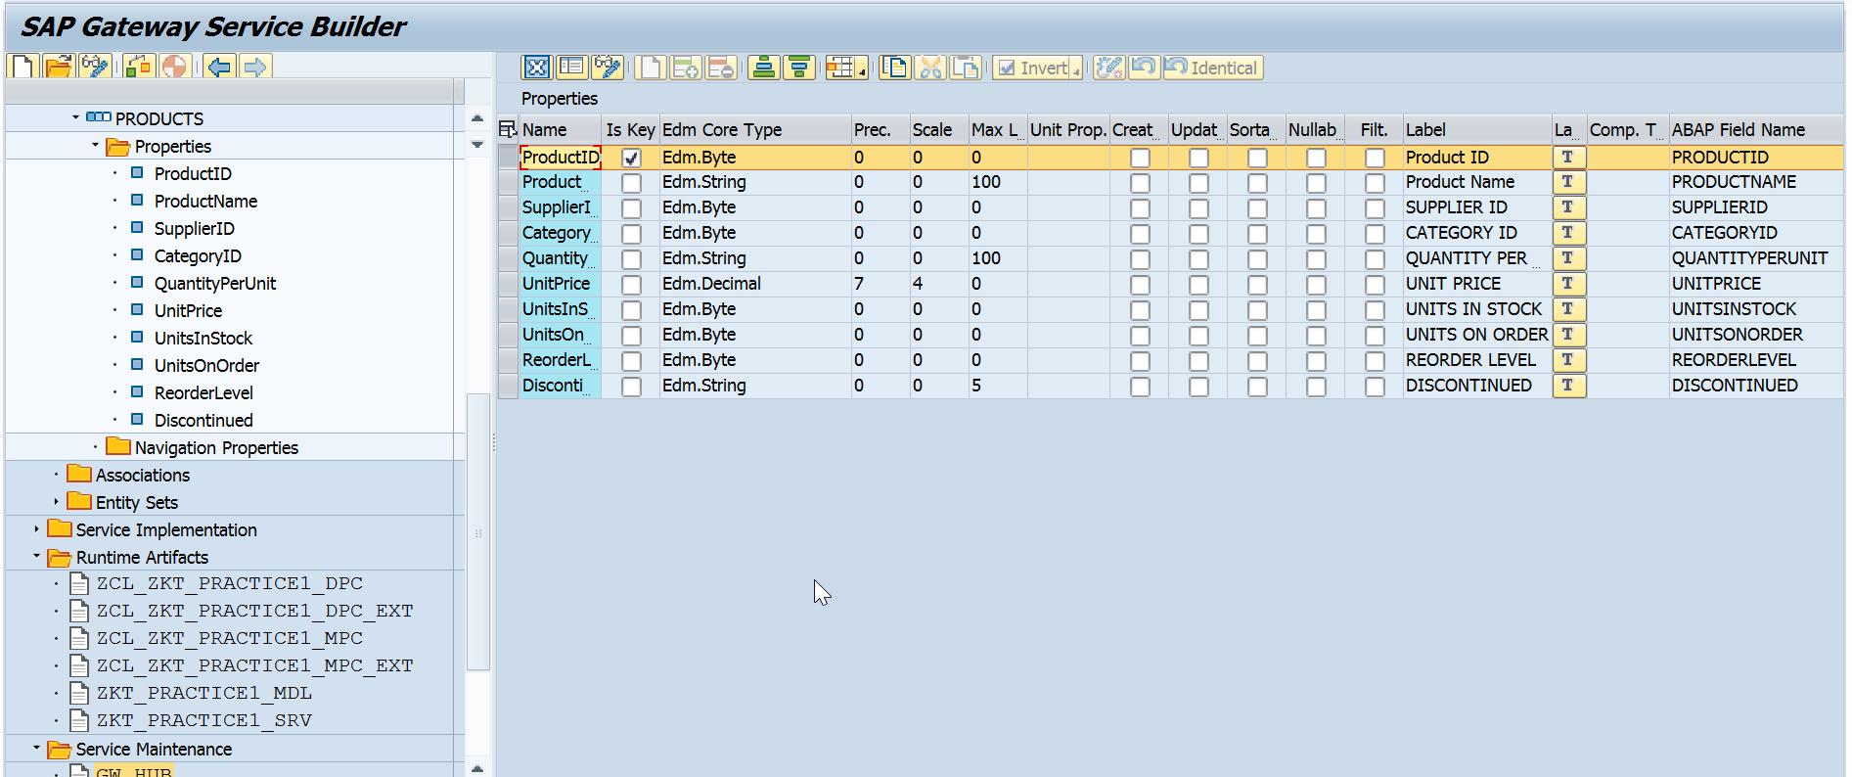
Gateway Design
Central Hub Deploy
16
Internal | RBVH/ETI22 | 2017-12-06
© Robert Bosch Engineering and Business Solutions Vietnam Company Limited 2017. All rights reserved, also regarding any disposal, exploitation, reproduction, editing, distribution, as well as in the event of applications for industrial property rights.

Slide 17
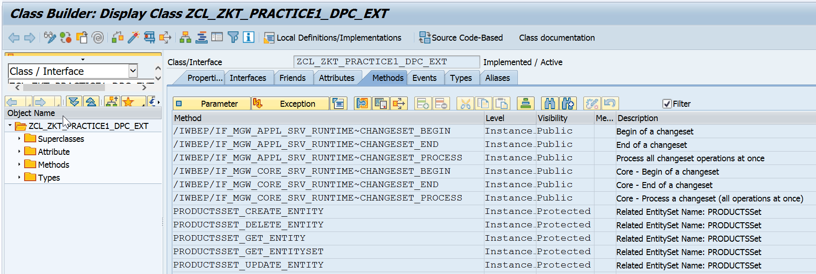
Gateway Implementation
2nd Level Support For Fiori
17
Internal | RBVH/ETI22 | 2017-12-06
© Robert Bosch Engineering and Business Solutions Vietnam Company Limited 2017. All rights reserved, also regarding any disposal, exploitation, reproduction, editing, distribution, as well as in the event of applications for industrial property rights.

Slide 18
Net weaver Gateway Debugging
2nd Level Support For Fiori
18
Internal | RBVH/ETI22 | 2017-12-06
© Robert Bosch Engineering and Business Solutions Vietnam Company Limited 2017. All rights reserved, also regarding any disposal, exploitation, reproduction, editing, distribution, as well as in the event of applications for industrial property rights.

Slide 19
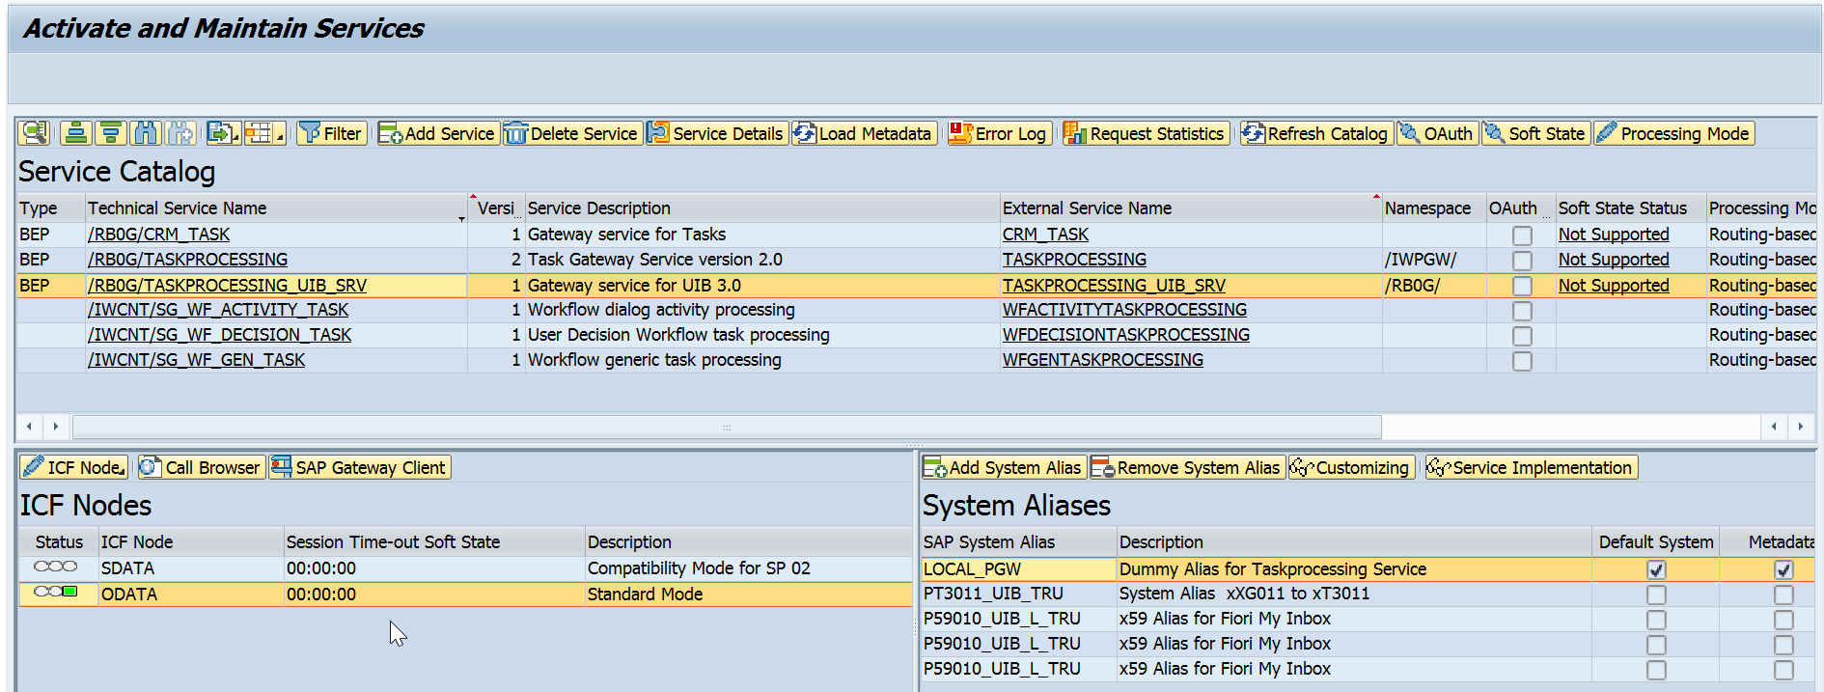
Maintenance Service (/IWFND/MAINT_SERVICE)
2nd Level Support For Fiori
SICF is active
RFC is connected
19
Internal | RBVH/ETI22 | 2017-12-06
© Robert Bosch Engineering and Business Solutions Vietnam Company Limited 2017. All rights reserved, also regarding any disposal, exploitation, reproduction, editing, distribution, as well as in the event of applications for industrial property rights.

Slide 20
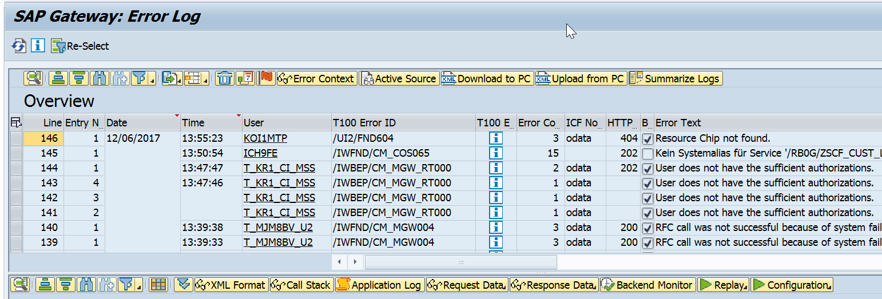
Gateway Log (/IWFND/ERROR_LOG)
2nd Level Support For Fiori
Backend or Frontend issue
Root to Basic team to check trust RFC if no error in SU53
Root to authorization team if error in SU53
Root to basic team to check RFC
20
Internal | RBVH/ETI22 | 2017-12-06
© Robert Bosch Engineering and Business Solutions Vietnam Company Limited 2017. All rights reserved, also regarding any disposal, exploitation, reproduction, editing, distribution, as well as in the event of applications for industrial property rights.

Slide 21
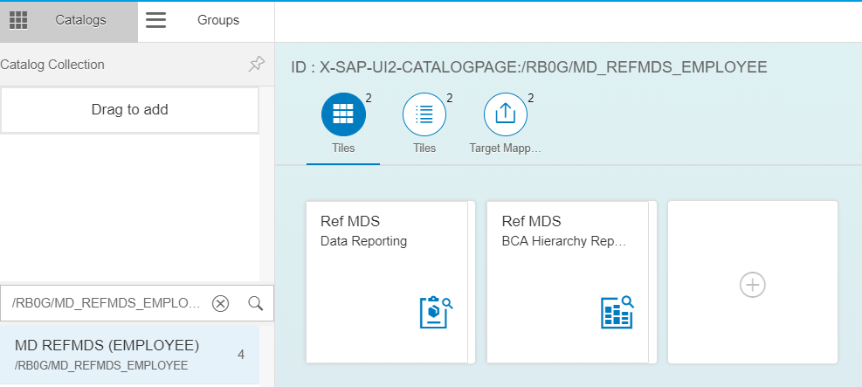
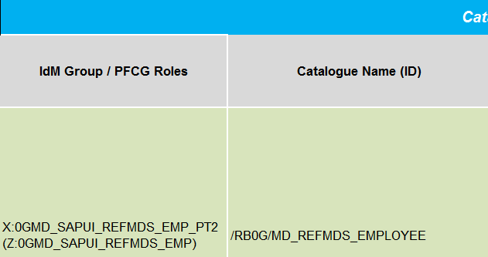
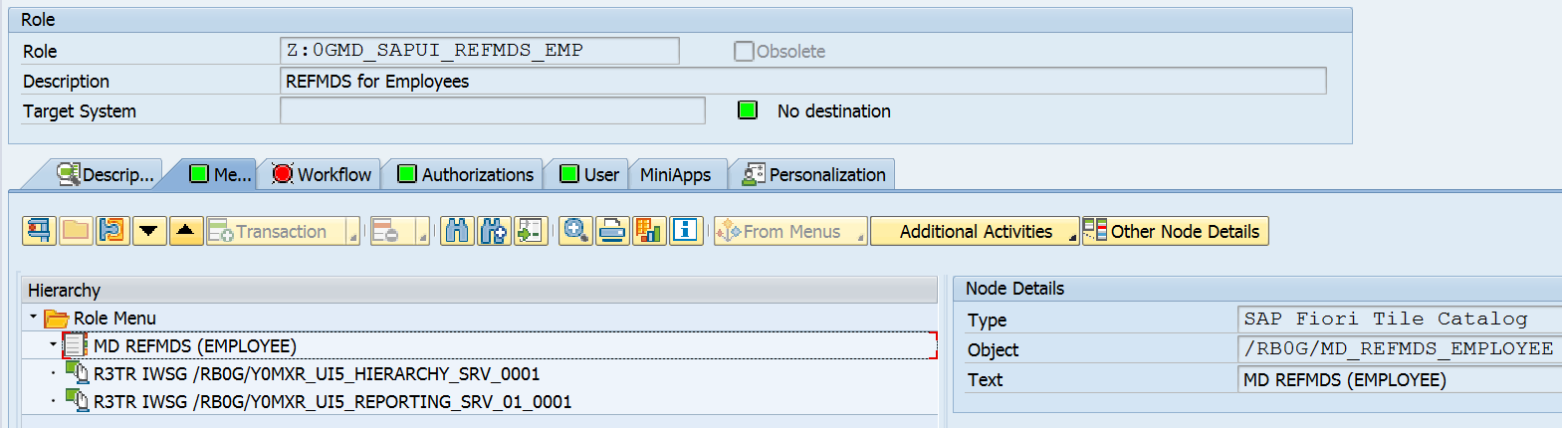
Fiori Launchpad Catalog & Group
21
Internal | RBVH/ETI22 | 2017-12-06
© Robert Bosch Engineering and Business Solutions Vietnam Company Limited 2017. All rights reserved, also regarding any disposal, exploitation, reproduction, editing, distribution, as well as in the event of applications for industrial property rights.

Slide 22
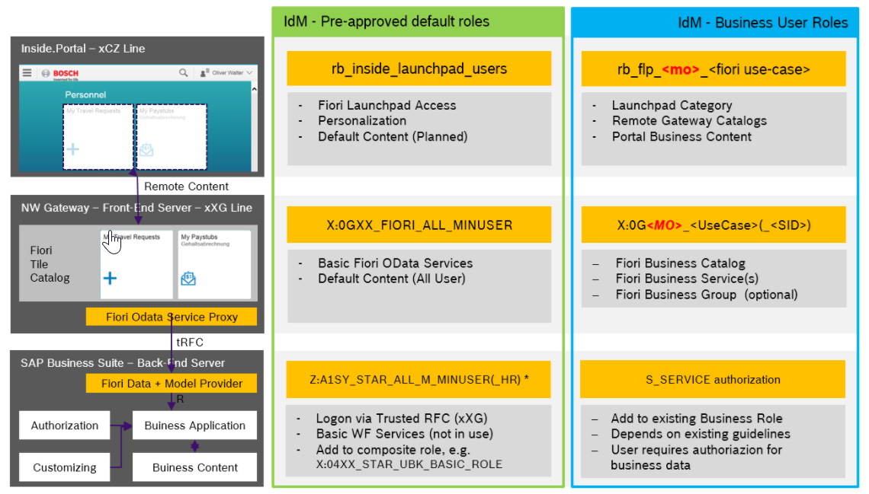
Authorization – Role Concept
2nd Level Support For Fiori
22
Internal | RBVH/ETI22 | 2017-12-06
© Robert Bosch Engineering and Business Solutions Vietnam Company Limited 2017. All rights reserved, also regarding any disposal, exploitation, reproduction, editing, distribution, as well as in the event of applications for industrial property rights.

Slide 23
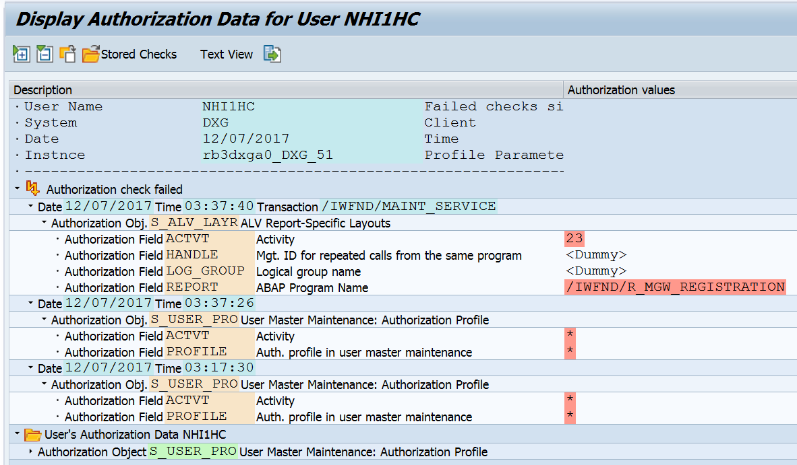
Authorization – SU53 (Check Missing Objects)
2nd Level Support For Fiori
23
Internal | RBVH/ETI22 | 2017-12-06
© Robert Bosch Engineering and Business Solutions Vietnam Company Limited 2017. All rights reserved, also regarding any disposal, exploitation, reproduction, editing, distribution, as well as in the event of applications for industrial property rights.

Slide 24
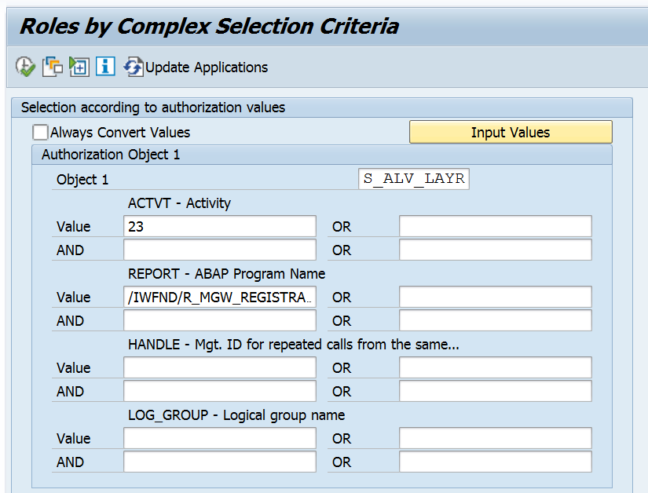
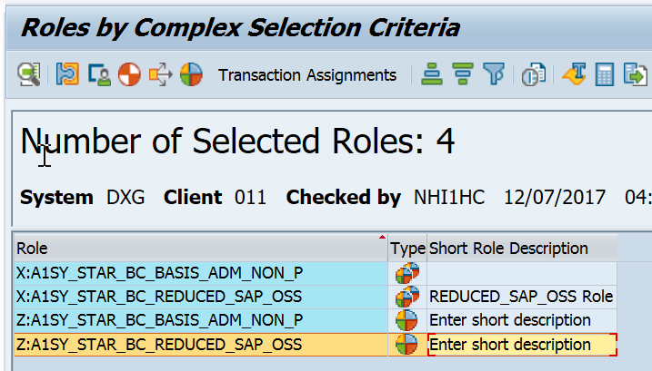
Authorization – SUIM (Find Role)
2nd Level Support For Fiori
24
Internal | RBVH/ETI22 | 2017-12-06
© Robert Bosch Engineering and Business Solutions Vietnam Company Limited 2017. All rights reserved, also regarding any disposal, exploitation, reproduction, editing, distribution, as well as in the event of applications for industrial property rights.

Slide 25


Question & Answer
Fiori Development Strategy
25
Internal | RBVH/ETI22 | 2017-12-06
© Robert Bosch Engineering and Business Solutions Vietnam Company Limited 2017. All rights reserved, also regarding any disposal, exploitation, reproduction, editing, distribution, as well as in the event of applications for industrial property rights.

